Slide 1
Camera Privacy Toggle
Administrator Training
Temporarily disable cameras for privacy • Automated safety net • Group-based access
Valley City State University | Capstone Project | March 2026
Larry Herzog Jr.

Slide 2






Agenda
What the Camera Toggle Does
How Privacy Mode Works
Using the Dashboard
Camera Groups (URL-Based)
Nightly Safety Net
Access via Admin Portal

Slide 3
What the Camera Toggle Does
Temporarily disable cameras for privacy-sensitive situations

Slide 4
The Problem & Solution
The Problem
The Solution
Office spaces occasionally need to serve as changing rooms
Cameras must be disabled during these times for privacy
Logging into Protect UI is cumbersome for quick toggles
Risk of forgetting to re-enable cameras afterward
One-click toggle from a simple web dashboard
Stops recording AND blacks out live feed
Restores original recording mode when re-enabled
Nightly safety net re-enables all cameras at 11 PM
Access: http://<server-ip>:5000 (standalone) or http://<server-ip>:8080 > Cameras tab (portal)

Slide 5
How Privacy Mode Works
What happens when you toggle a camera off

Slide 6
What Happens When You Toggle Off
Recording Stops
Live Feed Blacked Out
Recording mode is set to "never" — the NVR stops writing footage for this camera. No video is stored while the camera is off.
A full-frame privacy zone covers the entire view. Anyone opening the Protect app sees a black screen — no peeking.
When You Toggle Back On
The original recording mode is restored (e.g., if it was "motion" before, it goes back to "motion" — not forced to "always"). Privacy zone is removed. Camera resumes normal operation immediately. No reboot needed.
Hardware stays powered: The camera stays connected and powered during privacy mode. Restoration is instant — no boot cycle.

Slide 7
Using the Dashboard
The toggle interface walkthrough

Slide 8
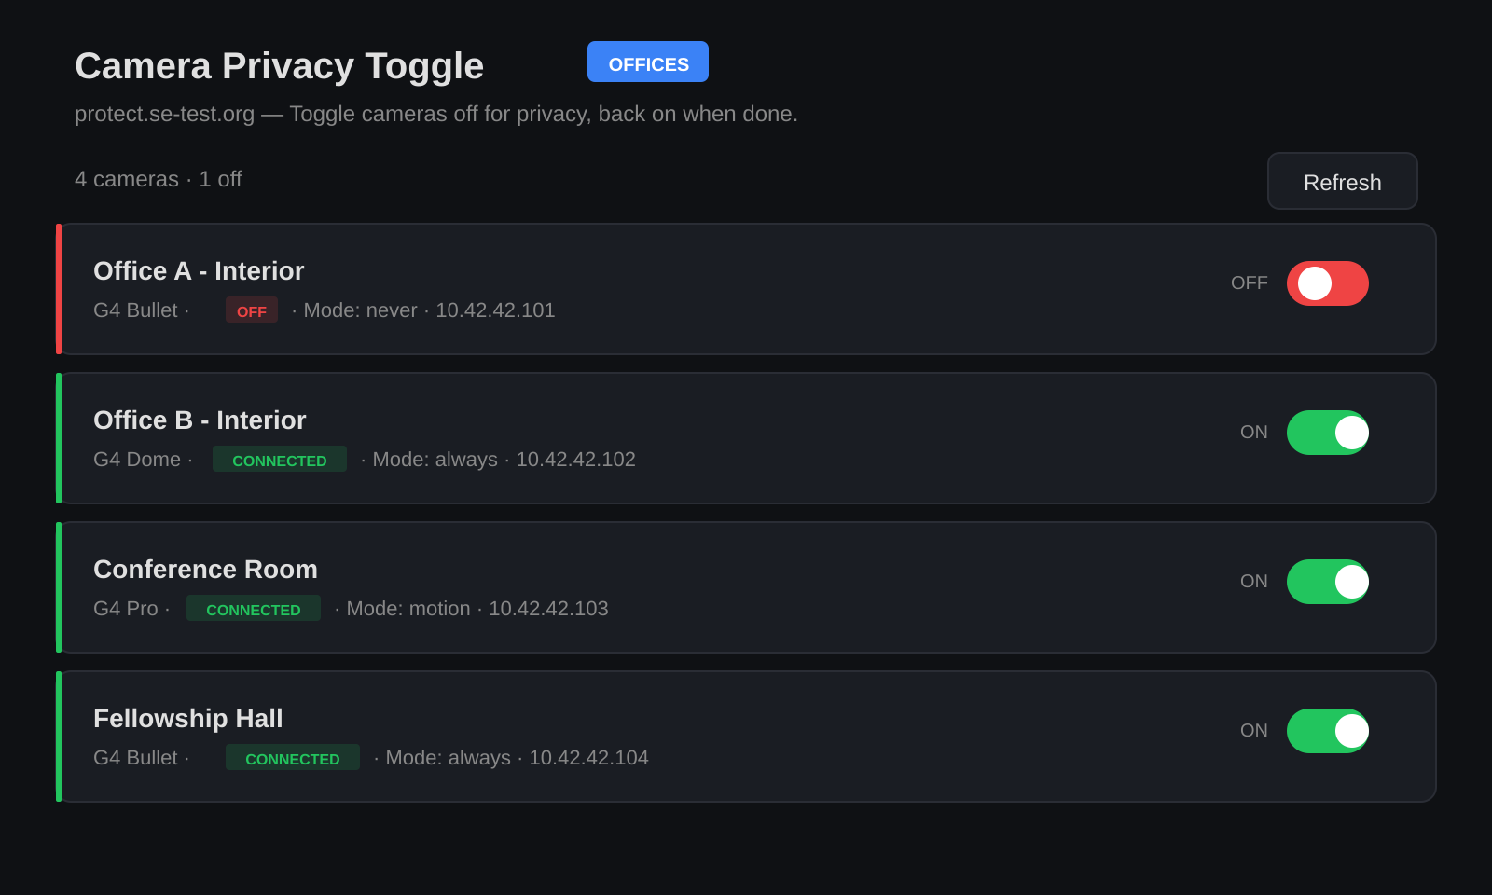
The Camera Dashboard
1. Summary bar
Shows camera count and how many are off
2. Camera cards
Green border = recording, Red border = off
3. Status badge
CONNECTED or OFF with recording mode
4. Toggle switch
Green = on, Red = off. Click to toggle.
5. Group badge
Blue label shows which camera group you're viewing

Slide 9
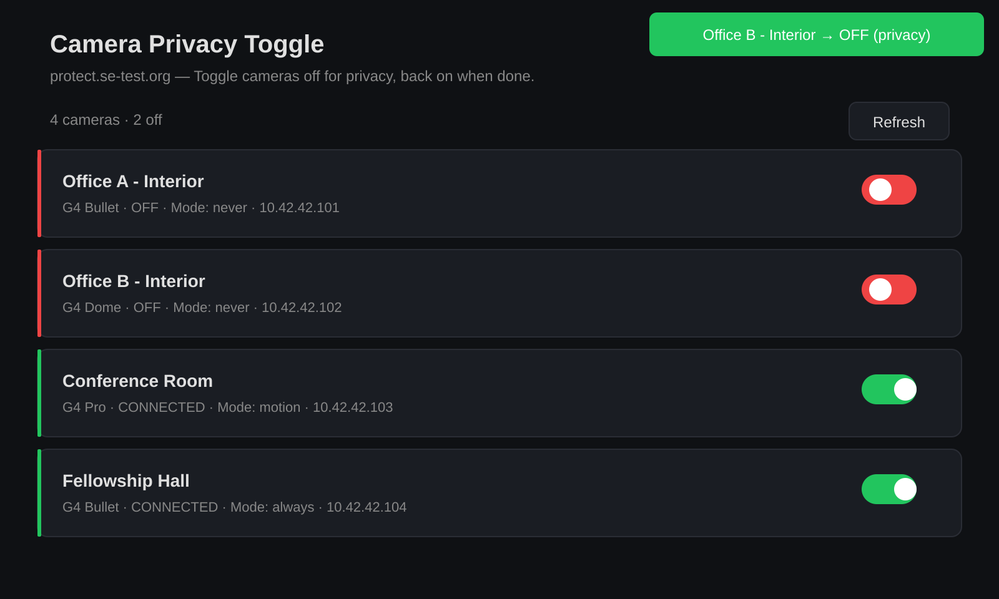
Toggling a Camera Off
Step by step:
1. Find the camera in the list
2. Click the green toggle switch
3. Switch turns red, label shows "OFF"
4. Toast confirms the action
5. Badge updates to OFF inline
To re-enable:
Click the red toggle — camera restores to its original recording mode.
Note: The green toast notification confirms the action. If an error occurs, a red toast appears and the toggle reverts.

Slide 10
Camera Groups
URL-based filtering for different administrators

Slide 11
URL-Based Camera Groups
URL | What You See
http://<ip>:5000/ | Default group — all managed cameras
http://<ip>:5000/bob | Only cameras in Bob's group
http://<ip>:5000/alice | Only cameras in Alice's group
How it works:
• Groups are defined in config.py under CAMERA_GROUPS
• Each group key becomes a URL path
• Non-default groups show a blue badge on the page title
• Unknown group names return a 404 with available groups listed
• The toggle API works on any camera regardless of group
• Groups filter the view only — not the permissions
Admin Portal: The portal's Cameras tab always shows ALL cameras (unfiltered). Use group URLs for role-specific views.

Slide 12
Nightly Safety Net
Automated camera restoration at 11 PM

Slide 13
The 11 PM Safety Net
What it does:
A cron job runs every night at 11:00 PM that:
• Connects to the Protect controller independently
• Checks every camera across ALL groups
• Re-enables any camera with recording mode set to "never"
• Clears any active privacy zones
• Restores the default recording mode (configured in config.py)
This ensures no camera is accidentally left off overnight.
Manual run: Admins can run the safety net manually: .venv/bin/python3 ensure_all_on.py (or --dry-run to preview).

Slide 14
Access via Admin Portal
One URL for cameras, doors, and monitoring

Slide 15
Admin Portal — http://<ip>:8080
The Camera Privacy Toggle is one of three tabs in the unified Admin Portal:
• Cameras tab — the same toggle interface, showing all cameras (unfiltered)
• Doors tab — door lock/unlock controls
• Monitor tab — real-time hardware health
The active tab persists across page refreshes. If one backend is down, the other tabs still work.
Tip: For group-filtered views, use the standalone URLs (port 5000). The portal always shows the full camera list.

Slide 16
Quick Reference
Task | How
Disable a camera | Click the green toggle switch
Re-enable a camera | Click the red toggle switch
View a specific group | http://<ip>:5000/<group_name>
Access via portal | http://<ip>:8080 > Cameras tab
Check safety net log | tail -50 /var/log/camera-ensure.log
Run safety net manually | .venv/bin/python3 ensure_all_on.py
Restart the service | sudo systemctl restart camera-toggle

Slide 17
Questions?
Thank you for attending.

